Slide 1
Data Analytics vs. Data Science

Slide 2
Data Analytics vs. Data Science
Business Intelligence Analyst
Data Analyst
Data Scientist

Slide 3
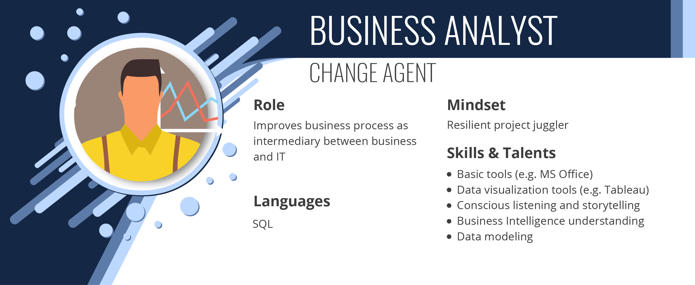

Slide 4
Business Metrics

Slide 5
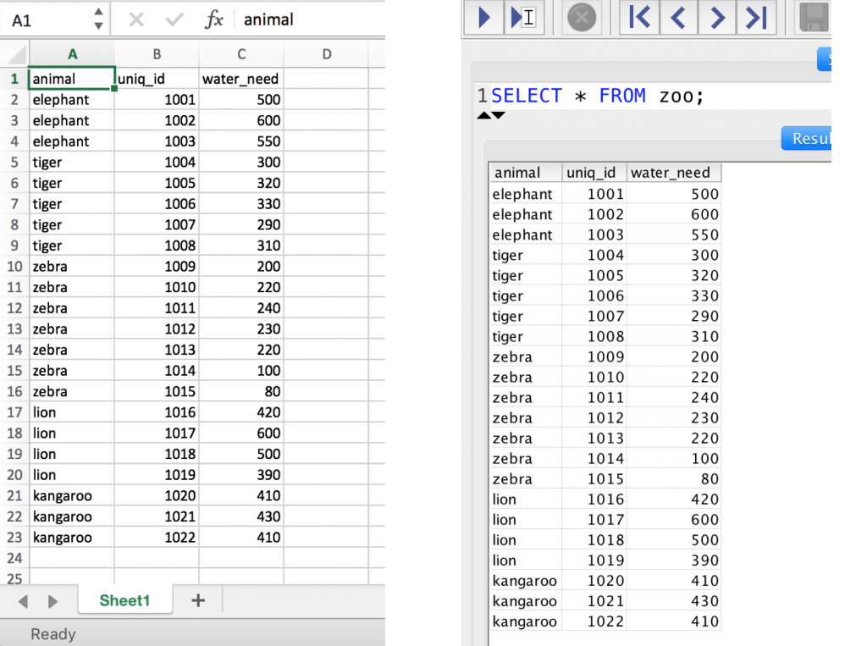



Slide 6
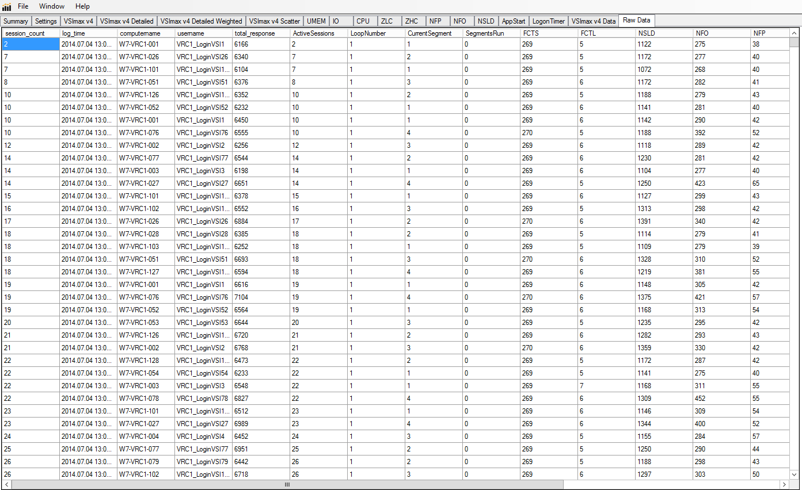

Slide 7
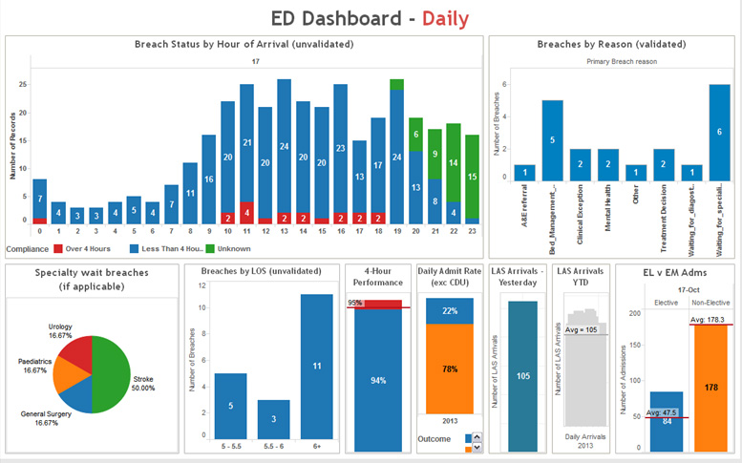
Dashboard

Slide 8


Business (BI) Analyst

Slide 9
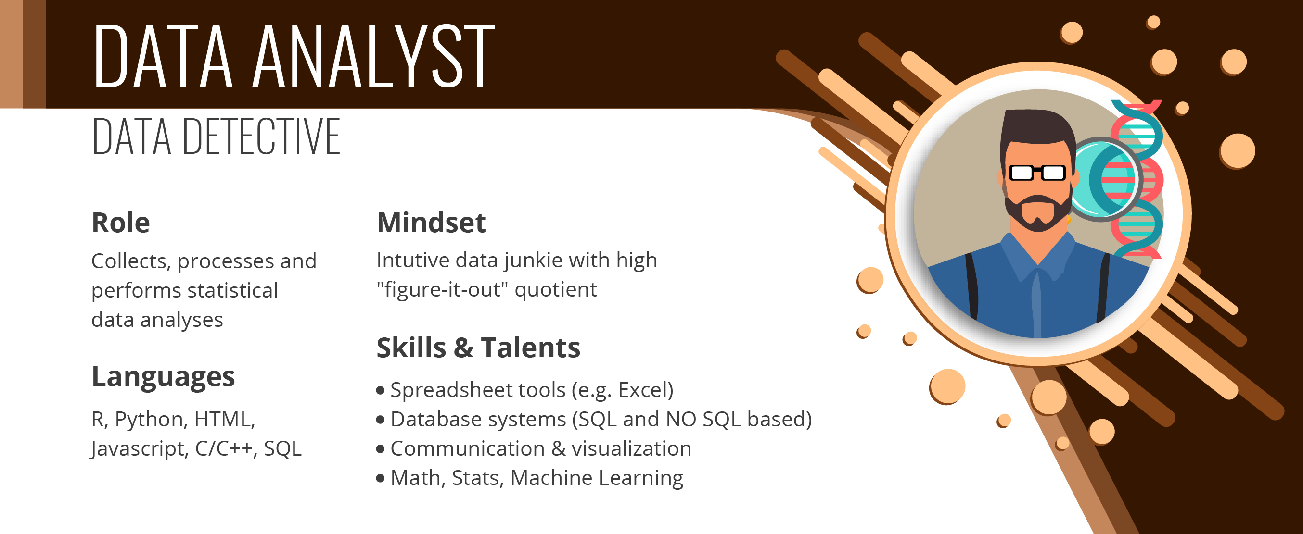

Slide 10
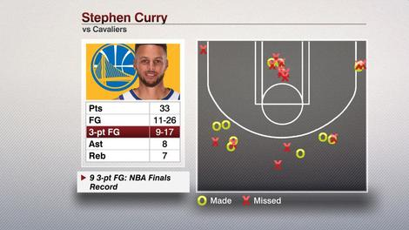

Slide 11
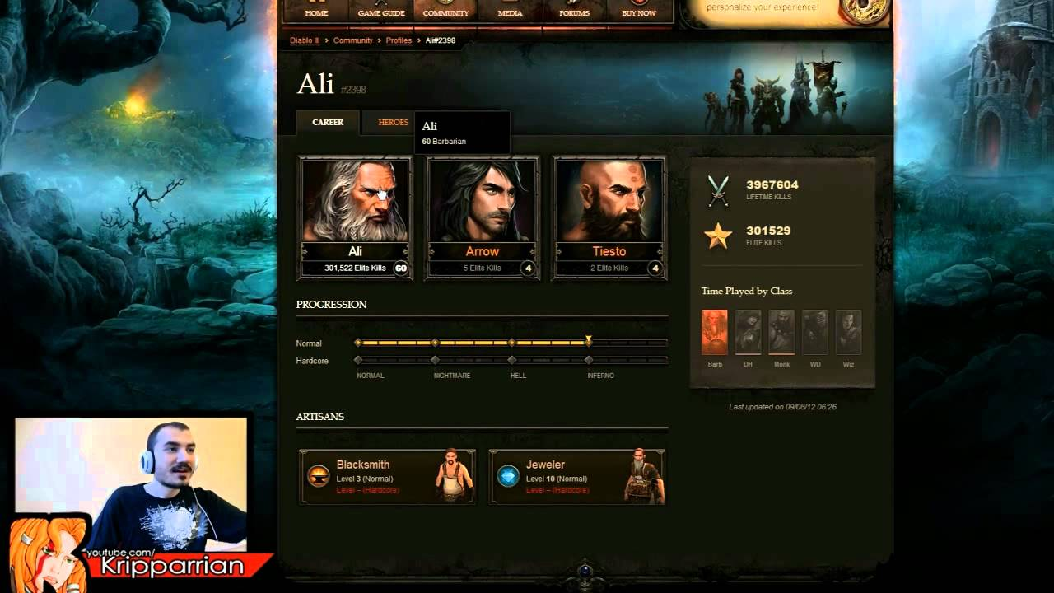

Slide 12
Data Analytics Stages
Category Purpose
Descriptive Analytics: What happened?
Exploratory Analytics: What’s important?
Predictive Analytics: What is likely to happen?
Prescriptive Analytics: What should I do?

Slide 13
Descriptive Analytics
Product Purchases
Age Groups | Monthly Transactions | Average Transaction Amt.
< 40 | 67 | $48.61
40 - 60 | 112 | $95.39
60 < | 43 | $61.22
Total | 222 | $68.40

Slide 14
Descriptive Analytics
Product Purchases
Age Groups | Monthly Transactions | Average Transaction Amt.
< 40 | 67 | $48.61
40 - 60 | 112 | $95.39
60 < | 43 | $61.22
Total | 222 | $68.40

Slide 15
Descriptive Analytics
Product Purchases
Age Groups | Monthly Transactions | Average Transaction Amt.
< 40 | 67 | $48.61
40 - 60 | 112 | $95.39
60 < | 43 | $61.22
Total | 222 | $68.40

Slide 16
Exploratory Analytics
Product Discounts
Gender | 20% | 30% | 40% | 50% | 60% | Ave.
Female | 14.99% | 17.61 | 20.92 | 20.73 | 26.08 | 20.06
Male | 9.76% | 15.23% | 16.90 | 20.16 | 26.74 | 17.75
Ave. | 12.38 | 16.42 | 18.91 | 20.45 | 26.41

Slide 17
Exploratory Analytics
Product Discounts
Gender | 20% | 30% | 40% | 50% | 60% | Ave.
Female | 14.99% | 17.61 | 20.92 | 20.73 | 26.08 | 20.06
Male | 9.76% | 15.23% | 16.90 | 20.16 | 26.74 | 17.75
Ave. | 12.38 | 16.42 | 18.91 | 20.45 | 26.41

Slide 18
Exploratory Analytics
Product Discounts
Gender | 20% | 30% | 40% | 50% | 60% | Ave.
Female | 14.99% | 17.61 | 20.92 | 20.73 | 26.08 | 20.06
Male | 9.76% | 15.23% | 16.90 | 20.16 | 26.74 | 17.75
Ave. | 12.38 | 16.42 | 18.91 | 20.45 | 26.41

Slide 19
Exploratory Analytics
Product Discounts
Gender | 20% | 30% | 40% | 50% | 60% | Ave.
Female | 14.99% | 17.61 | 20.92 | 20.73 | 26.08 | 20.06
Male | 9.76% | 15.23% | 16.90 | 20.16 | 26.74 | 17.75
Ave. | 12.38 | 16.42 | 18.91 | 20.45 | 26.41

Slide 20
Exploratory Analytics
Product Discounts
Gender | 20% | 30% | 40% | 50% | 60% | Ave.
Female | 14.99% | 17.61 | 20.92 | 20.73 | 26.08 | 20.06
Male | 9.76% | 15.23% | 16.90 | 20.16 | 26.74 | 17.75
Ave. | 12.38 | 16.42 | 18.91 | 20.45 | 26.41

Slide 21

Predictive Analytics

Slide 22

Predictive Analytics
Customer 360
Visited Website
Age
Called Sales
Gender
Responded to an email
Employment

Slide 23
Customer Data
Demographics
Name | Carl
Age | 38
Gender | M
Employed | Yes
Income | 75,000
Married | Y
Children | 2

Slide 24
Customer Data
Behavior
Visited Website | Y
Bought Products | N
Received Emails | Y
Responded to Emails | N
Tweeted About You | N
Called Sales | Y

Slide 25
Real-Time Customer Data
Clicked Product | Viewed Summary | Clicked Similar Product | Compared Products | Checked Reviews | Buy
1 | 1 | 0 | 0 | 1 | 1
1 | 0 | 1 | 1 | 0 | 0
1 | 1 | 1 | 0 | 1 | 1
0 | 0 | 0 | 0 | 0 | 0
1 | 0 | 1 | 0 | 0 | 0
1 | 1 | 1 | 0 | 1 | 1
1 | 1 | 0 | 1 | 0 | 1

Slide 26



Machine Learning Model
DATA
ALGORITHM
MODEL

Slide 27

Demographics
Website Actions

Slide 28
Machine Learning
Demographics
Propensity Model
Website Actions

Slide 29
Propensity Score
(how likely they are to buy from you)
Action Sequence | Will Buy?
Clicked Product | 10%
Viewed Summary | 20%
Clicked Similar | 25%
Compared Products | 55%
Checked Reviews | 70%
Machine Learning
Demographics
Propensity Model
Website Actions

Slide 30
Propensity Score
(how likely they are to buy from you)
Customer | Score
Sara | .73
Al | .38
Roberta | .92
Theresa | .47
Alice | .24
Bobby | .82
Machine Learning
Demographics
Propensity Model
Website Actions

Slide 31
New Customer
Clicked Product | Viewed Summary | Clicked Similar Product | Compared Products | Checked Reviews | Buy
0 | 0 | 0 | 0 | 0 | ?

Slide 32
New Customer
Clicked Product | Viewed Summary | Clicked Similar Product | Compared Products | Checked Reviews | Buy
0 | 0 | 0 | 0 | 0 | .03
Probability

Slide 33
New Customer
Clicked Product | Viewed Summary | Clicked Similar Product | Compared Products | Checked Reviews | Buy
1 | 0 | 0 | 0 | 0 | .09
Probability

Slide 34
New Customer
Clicked Product | Viewed Summary | Clicked Similar Product | Compared Products | Checked Reviews | Buy
1 | 0 | 1 | 0 | 0 | .27
Probability

Slide 35

New Customer
Clicked Product | Viewed Summary | Clicked Similar Product | Compared Products | Checked Reviews | Buy
1 | 0 | 1 | 0 | 1 | .59
Probability

Slide 36

Chat

Slide 37
Prescriptive Analytics
Day of the Week | Offers | Conversion%
Sunday | 736 | 17.8%
Monday | 707 | 15.7%
Tuesday | 767 | 19.3%
Wednesday | 732 | 15.0%
Thursday | 712 | 17.3%
Friday | 741 | 17.3%
Saturday | 605 | 33.4%
 | 5000 | 19.1%

Slide 38
Prescriptive Analytics
Day of the Week | Offers | Conversion%
Sunday | 736 | 17.8%
Monday | 707 | 15.7%
Tuesday | 767 | 19.3%
Wednesday | 732 | 15.0%
Thursday | 712 | 17.3%
Friday | 741 | 17.3%
Saturday | 605 | 33.4%
 | 5000 | 19.1%

Slide 39
Decision Analysis
Cost
Benefits
Saturday Campaign
Opportunities
Threats

Slide 40


Data Analyst
Domain Knowledge

Slide 41
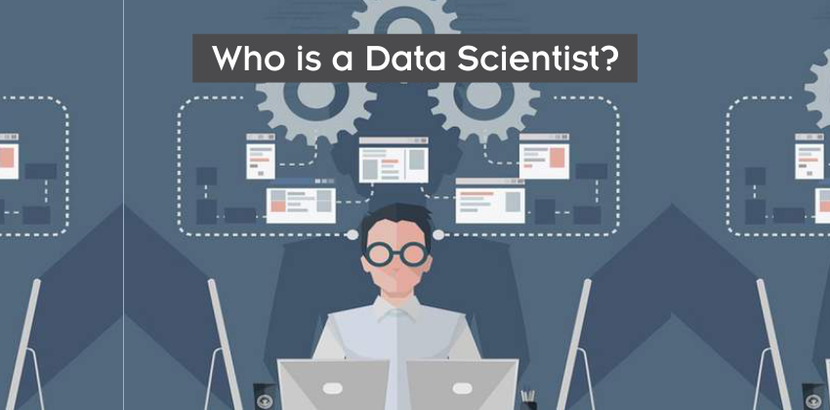

Slide 42

Data Scientist

Slide 43
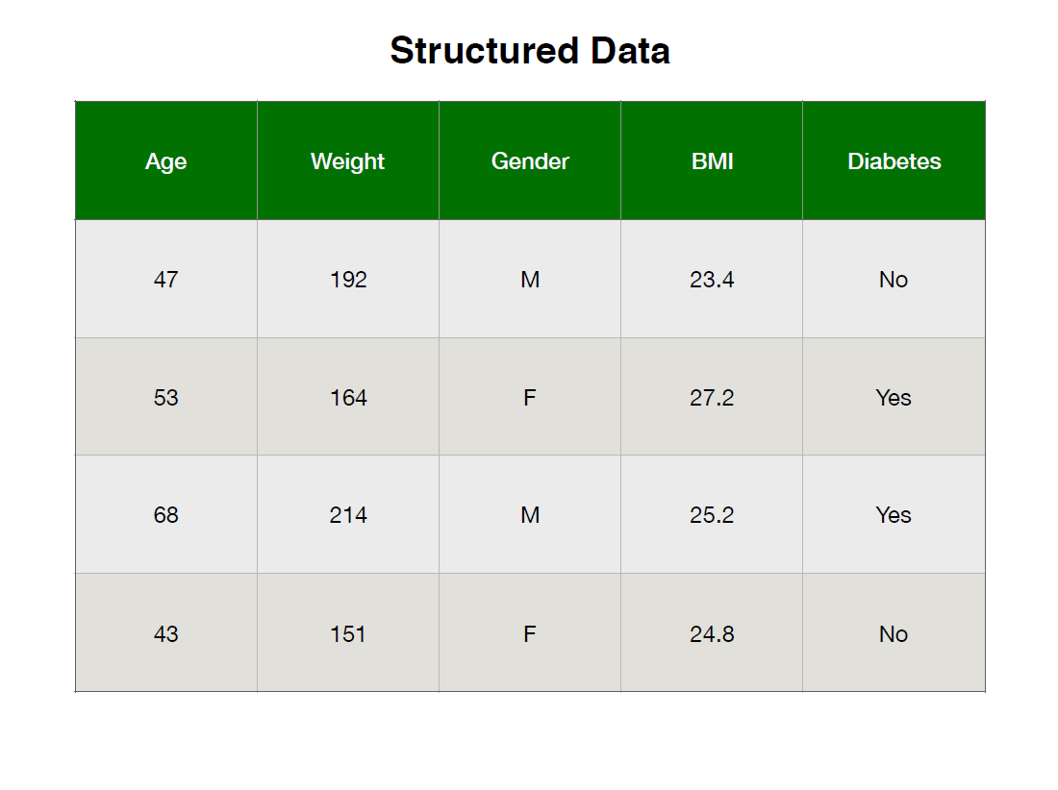

Slide 44
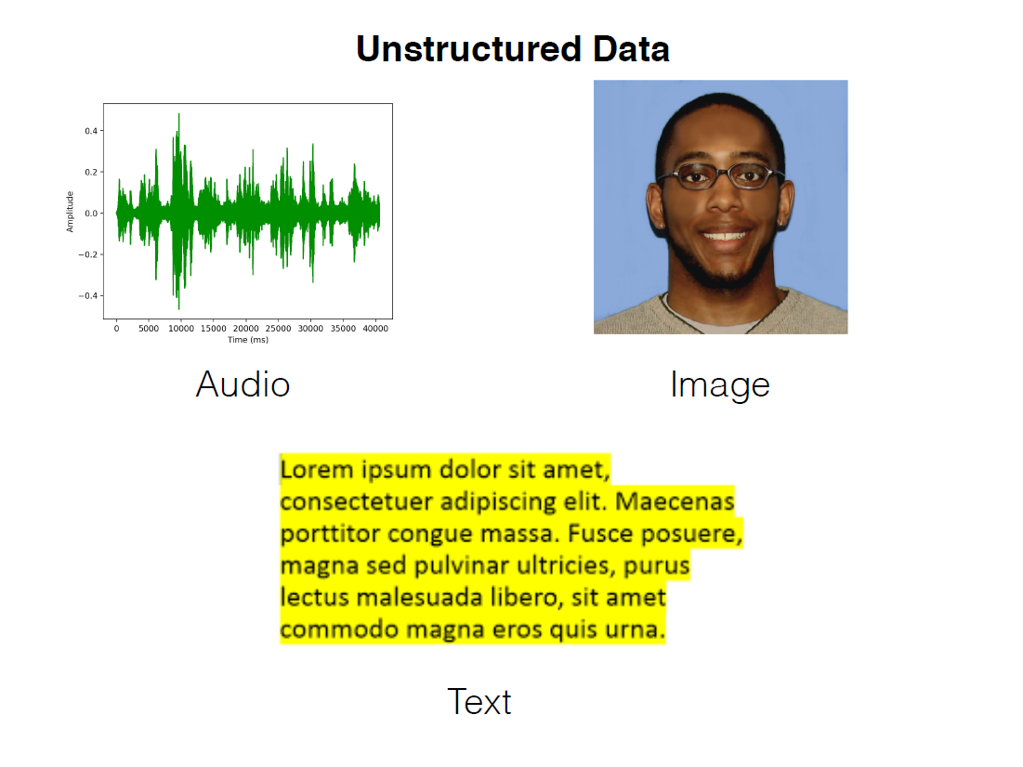

Slide 45




Slide 46
Comparison
Process | Data Engineering | Business Intelligence | Data Analytics | Data Science
Integrate Data Sources
Build Data Pipelines
Process and Transform Data
Store Data
Dashboards/Reports
Exploratory Analytics
Machine Learning
Specialized Domain Knowledge
Business Recommendations

Slide 47
Comparison
Process | Data Engineering | Business Intelligence | Data Analytics | Data Science
Integrate Data Sources | 
Build Data Pipelines | 
Process and Transform Data | 
Store Data | 
Dashboards/Reports
Exploratory Analytics
Machine Learning
Specialized Domain Knowledge
Business Recommendations

Slide 48
Comparison
Process | Data Engineering | Business Intelligence | Data Analytics | Data Science
Integrate Data Sources | 
Build Data Pipelines | 
Process and Transform Data | 
Store Data | 
Dashboards/Reports |  | 
Exploratory Analytics |  | 
Machine Learning
Specialized Domain Knowledge
Business Recommendations |  | 

Slide 49
Comparison
Process | Data Engineering | Business Intelligence | Data Analytics | Data Science
Integrate Data Sources | 
Build Data Pipelines | 
Process and Transform Data | 
Store Data | 
Dashboards/Reports |  |  | 
Exploratory Analytics |  |  | 
Machine Learning |  |  | 
Specialized Domain Knowledge |  |  | 
Business Recommendations |  |  | 

Slide 50
Comparison
Process | Data Engineering | Business Intelligence | Data Analytics | Data Science
Integrate Data Sources |  |  |  | 
Build Data Pipelines |  |  |  | 
Process and Transform Data |  |  |  | 
Store Data |  |  |  | 
Dashboards/Reports |  |  |  | 
Exploratory Analytics |  |  |  | 
Machine Learning |  |  |  | 
Specialized Domain Knowledge |  |  |  | 
Business Recommendations |  |  |  | 

Slide 55
Projects

Slide 56


Slide 57
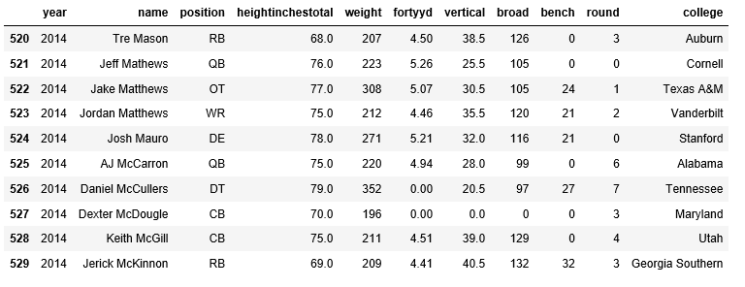

Slide 58
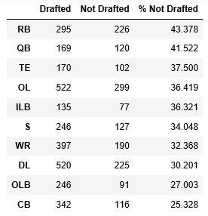

Slide 59
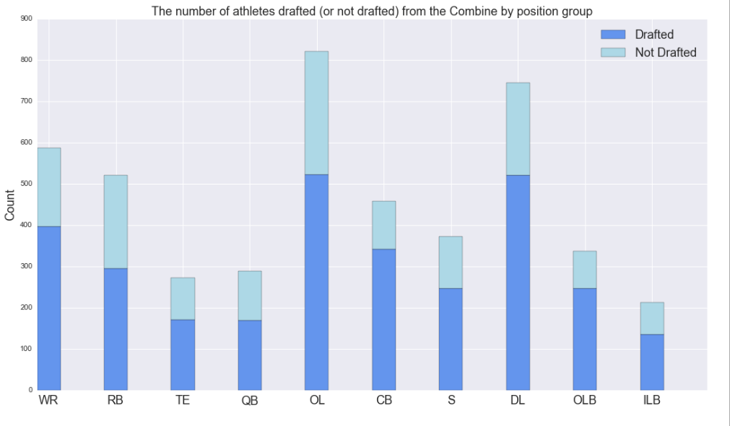

Slide 60
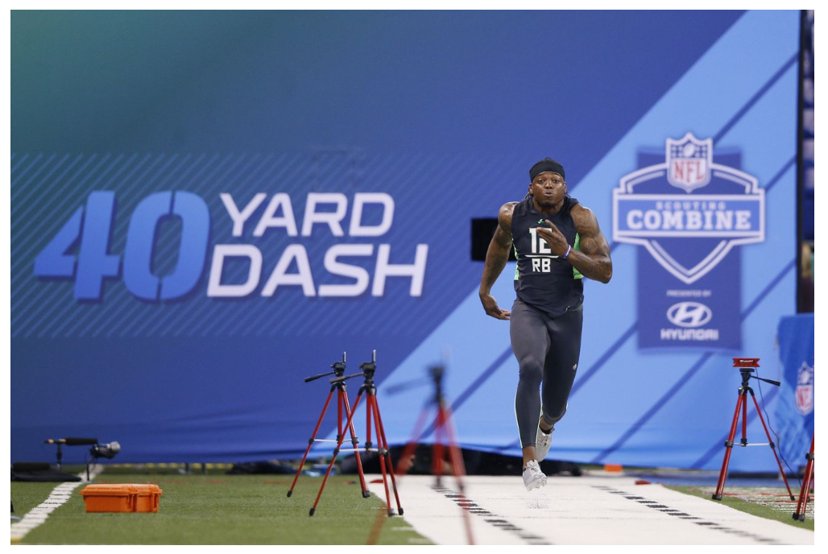

Slide 61
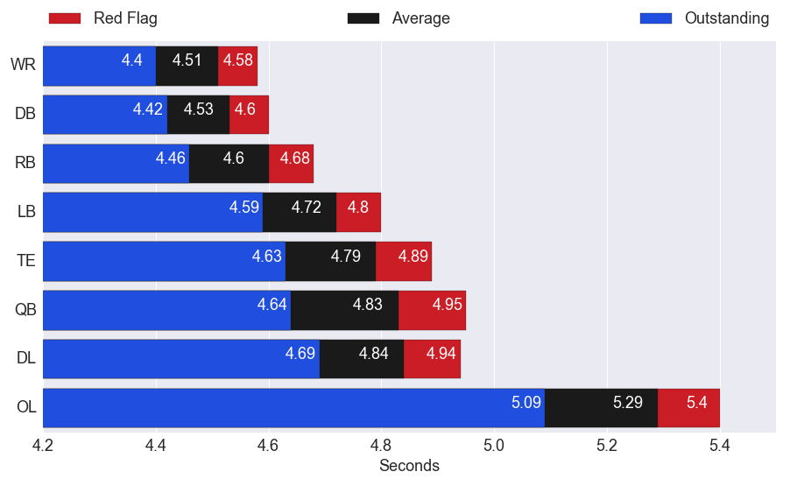

Slide 63
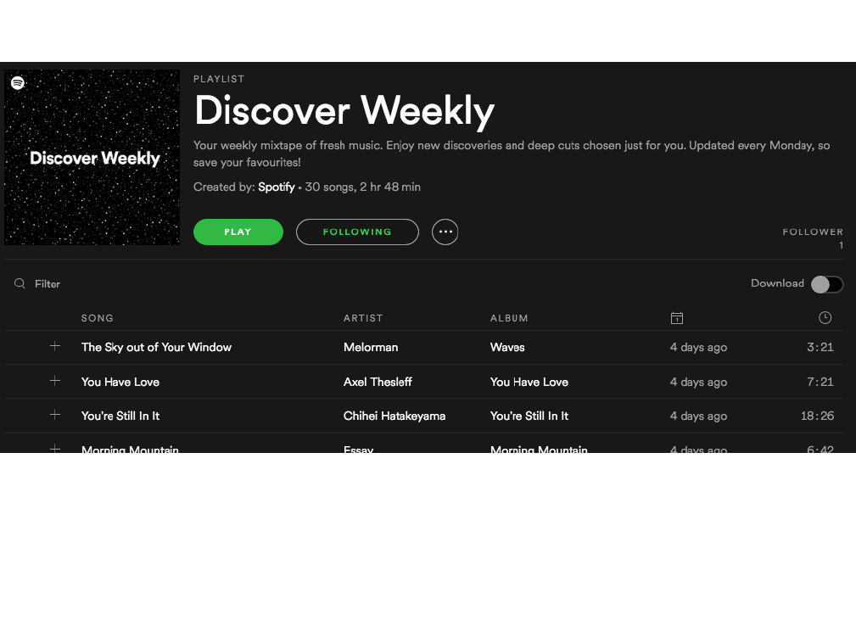

Slide 64
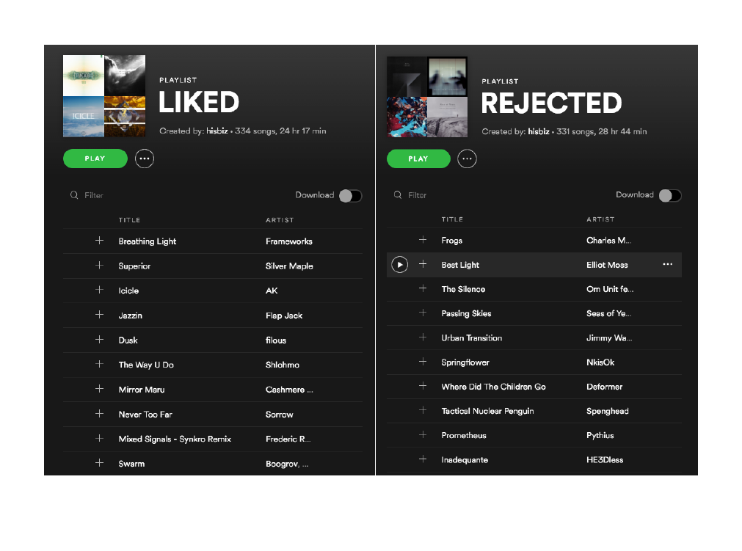

Slide 65


Slide 66
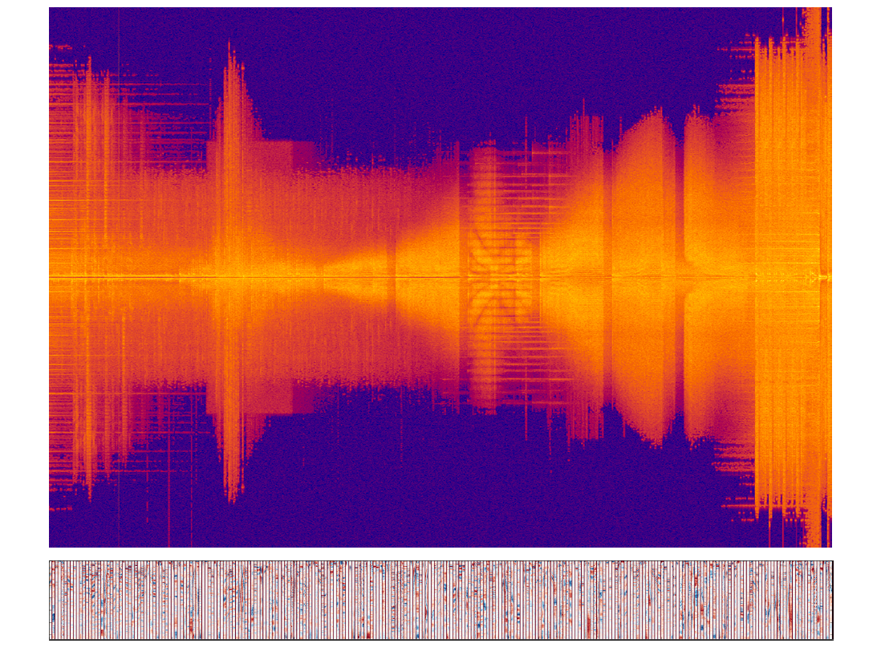

Slide 67
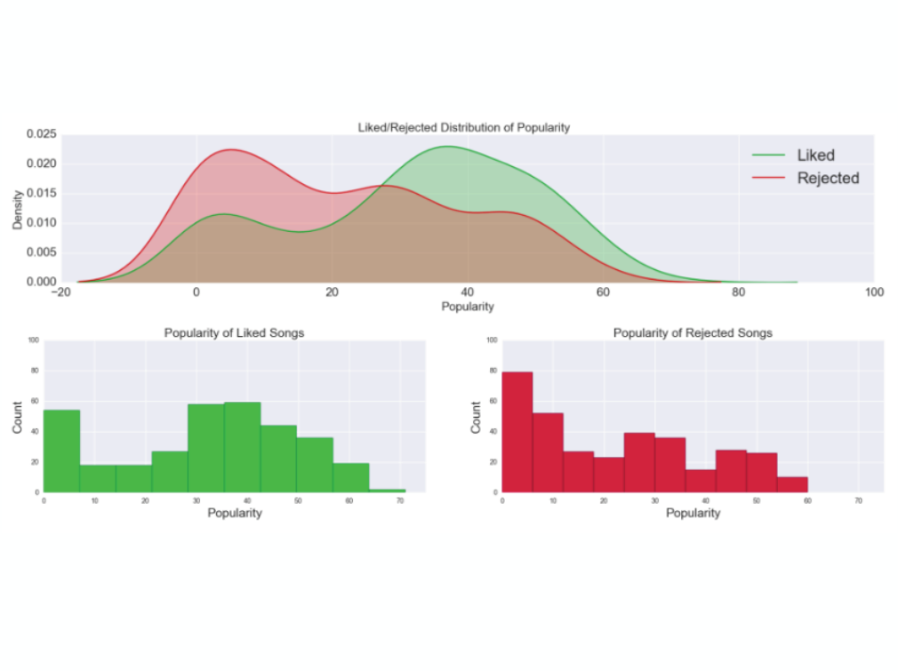

Slide 68
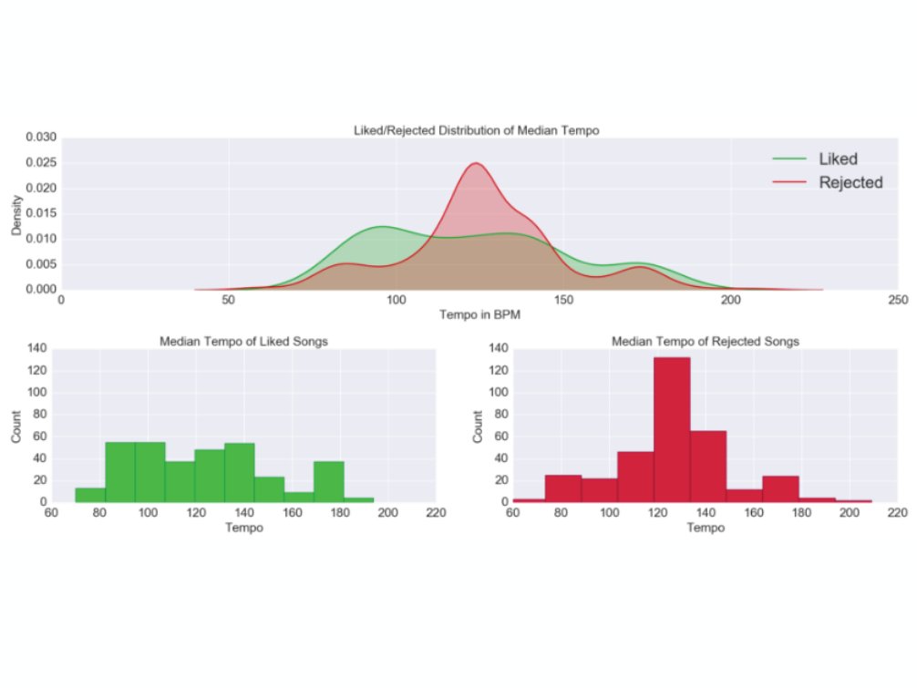

Slide 69
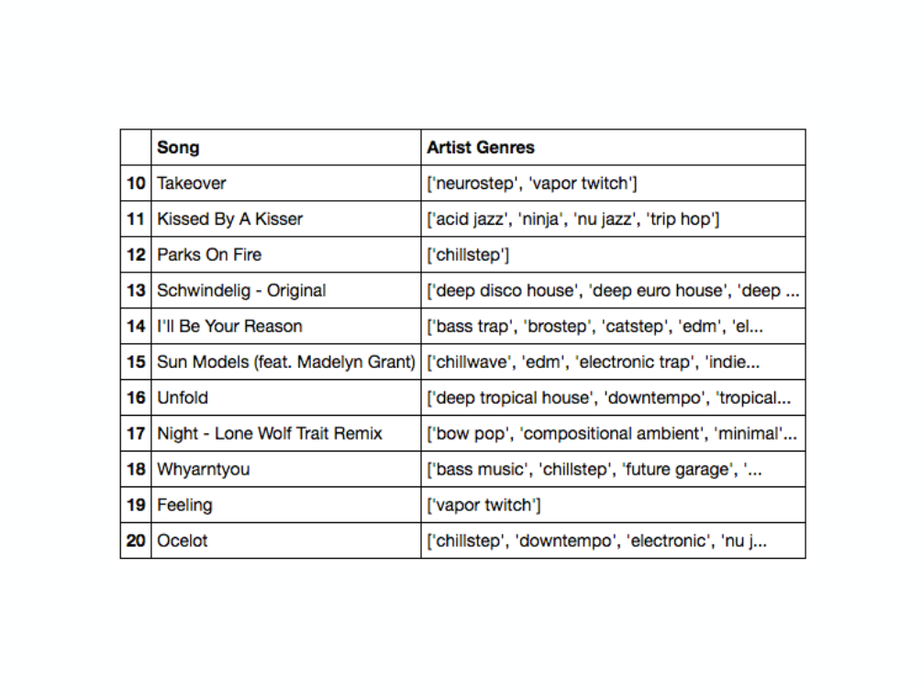

Slide 70
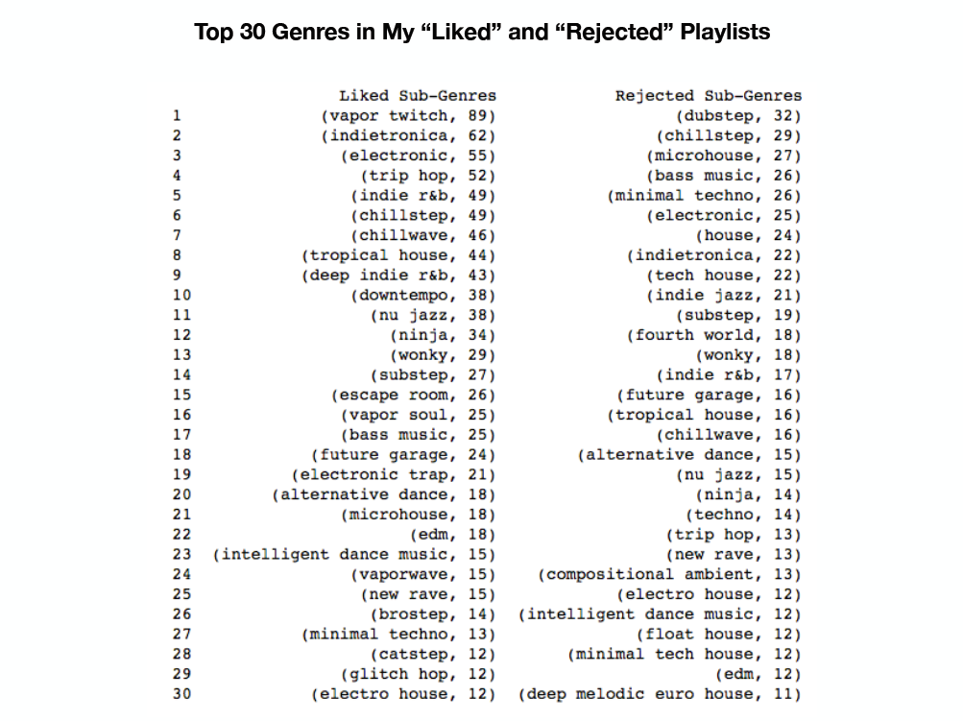

Slide 71
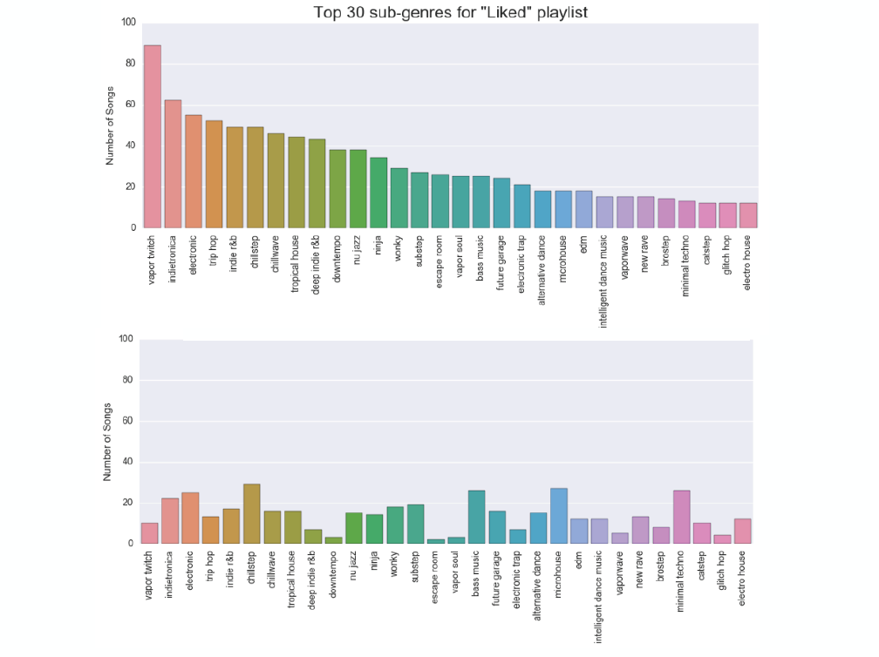

Slide 73
Data Analytics vs. Data Science

Slide 74

Data Analytics vs. Data Science
Business Intelligence Analyst

Slide 75

Data Analytics vs. Data Science
Data Analyst
Business Intelligence Analyst

Slide 76

Data Analytics vs. Data Science
Data Science
Data Analyst
Business Intelligence Analyst

Slide 77

Data Analytics vs. Data Science
Cloud Analytics
Data Science
Data Analyst
Business Intelligence Analyst

Slide 78

Next meeting: May 9, 2019 at 6 p.m.
Topic: Introduction to Machine Learning

Slide 80

Antony Ross
antony-ross
antonyross2k@gmail.com

Slide 81
Chat

Slide 82
New Prospect
Clicked Product | Viewed Summary | Clicked Similar Product | Compared Products | Checked Reviews | Buy
0 | 0 | 0 | 0 | 0 | 0
Prediction

Slide 83
Propensity Score
(how likely they are to buy from you)
Prospect | Score
Sara | .73
Al | .38
Roberta | .92
Theresa | .47
Steve | .75
Bobby | .82
Alice | .24

Slide 84

Chat

Slide 85
Cloud Analytics
Data Science
Data Analytics
Business Intelligence Analytics

Slide 86
Deep Learning

Slide 88
Data Analytics Stages
Category Purpose
Descriptive Analytics: Tell me what happened and why.
Exploratory Analytics: Tell me something important without me asking specific questions.
Predictive Analytics: Tell me what is likely to happen and why.
Prescriptive Analytics: Tell me what I should do.

Slide 89
Customer 360
Clicked on a product
Checking reviews

Slide 90
Identifying High-Propensity Prospects
Clicked Product | Looked at Reviews | Clicked Similar Product | Session Duration | Arrived from Search | Arrived from Link | Buy

Slide 91
Propensity Score
(how likely they are to buy from you)
Action | Buy?
Clicked Product | 10%
Viewed Summary | 20%
Clicked Similar | 25%
Compared Products | 55%
Checked Reviews | 70%
Machine Learning
Demographics
Propensity Model
Website Actions

Slide 92
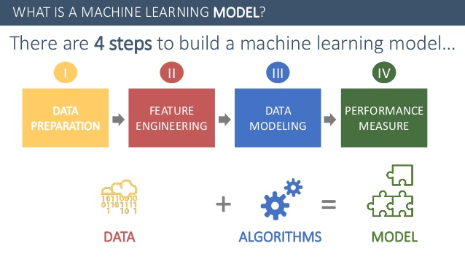

Slide 93


Slide 94
Machine Learning
Demographics
Propensity Model
Website Actions

Slide 95
Identifying High-Propensity Customers
Clicked Product | Viewed Summary | Clicked Similar Product | Compared Products | Checked Reviews | Buy
1 | 1 | 0 | 0 | 1 | 1
1 | 0 | 1 | 1 | 0 | 0
1 | 1 | 1 | 0 | 1 | 1
0 | 0 | 0 | 0 | 0 | 0
1 | 0 | 1 | 0 | 0 | 0
1 | 1 | 1 | 0 | 1 | 1
1 | 1 | 0 | 1 | 0 | 1

Slide 96
Prescriptive Analytics
Upsell
First Item | Second Item | Bought Together
Laptop | Bag | 40%
Laptop | External Hard Drive | 20%
Printer | Paper | 70%
Compared Products | Ink | 45%

Slide 97
Predictive Analytics
Best Future Customers
First Item | Second Item | Bought Together
Laptop | Bag | 40%
Laptop | External Hard Drive | 20%
Printer | Paper | 70%
Compared Products | Ink | 45%

Slide 98
Prescriptive Analytics

Slide 99
Prescriptive Analytics
Day of the Week | Offers | Conversion%
Sunday | 736 | 17.8%
Monday | 707 | 15.7%
Tuesday | 767 | 19.3%
Wednesday | 732 | 15.0%
Thursday | 712 | 17.3%
Friday | 741 | 17.3%
Saturday | 605 | 33.4%
 | 5000 | 19.1%

Slide 100
Comparison
Process | Data Engineering | Business Intelligence | Data Analytics | Data Science
Integrate Data Sources |  |  |  | 
Build Data Pipelines |  |  |  | 
Process and Transform Data |  |  |  | 
Store Data |  |  |  | 
Dashboards/Reports |  |  |  | 
Exploratory Analytics |  |  |  | 
Machine Learning |  |  |  | 
Specialized Domain Knowledge |  |  |  | 
Business Recommendations |  |  |  | 

Slide 101

Overview of position:
Advanced knowledge of Microsoft Excel
Turn data into business insights through data modeling.
Build advanced analytics capabilities, e.g. regression analysis, A/B testing.
Develop intuitive dashboards using various BI tools such as Tableau.
The ability to apply a business sense to data.

Slide 102

Data Analyst
Key Responsibilities:
Build dashboards and reports to enable smart decisions. Strong experience with data analytics software such as PowerBI or Tableau is a must.
Build qualitative and quantitative models to deepen understanding of operational performance.
Leverage analytics to drive process improvement.
Hands on SQL skills to retrieve and analyze data.
Strong knowledge of programming/scripting language highly desirable (e.g., Python, Java)
Experience in the heathcare industry is a plus.

Slide 103
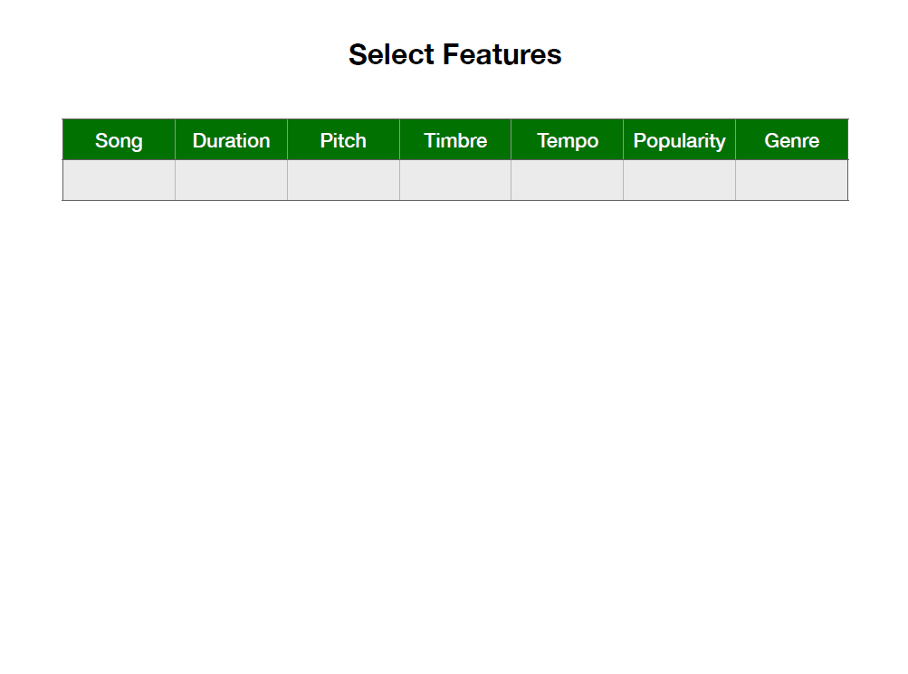

Slide 104
The Data Science Process
1.) Identify a Useful Question
2.) Acquire the Data
3.) Explore the Data
4.) Clean the Data
5.) Model the Data (ML)
6.) Communicate the Findings

Slide 105
The Data Science Process
1.) Identify a Useful Question
2.) Acquire the Data
3.) Explore the Data
4.) Clean the Data
5.) Model the Data (ML)
6.) Communicate the Findings

Slide 106
